Slide 1
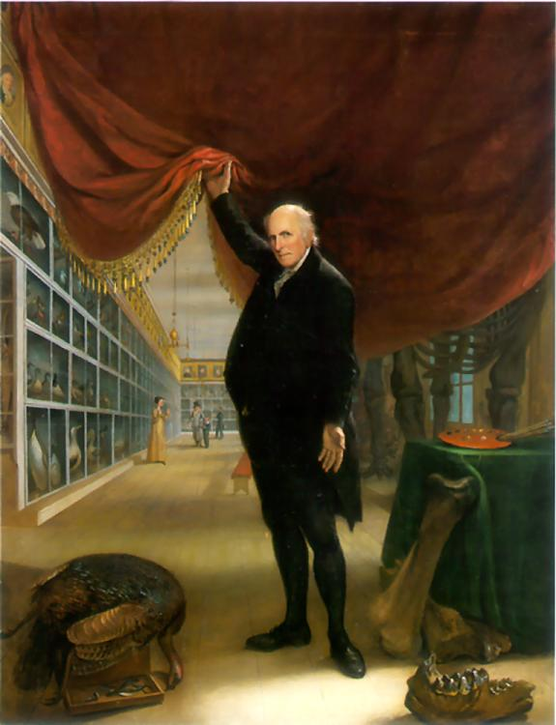
The Artist in His Museum
Charles Willson Peale
date: 1822

Slide 2
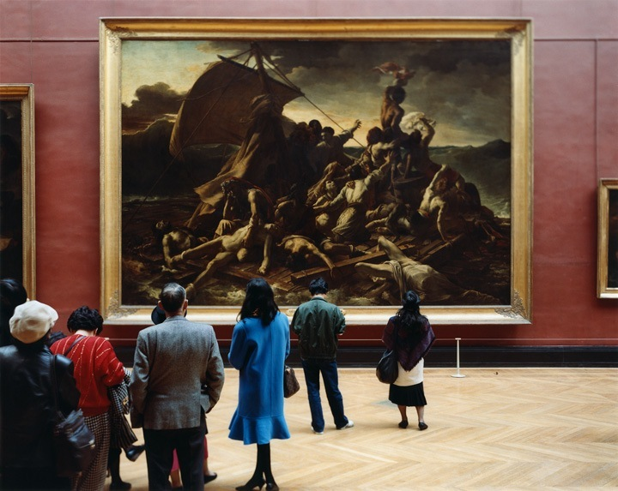
Musee Louvre IV, Paris
Thomas Struth
date: 1989

Slide 3
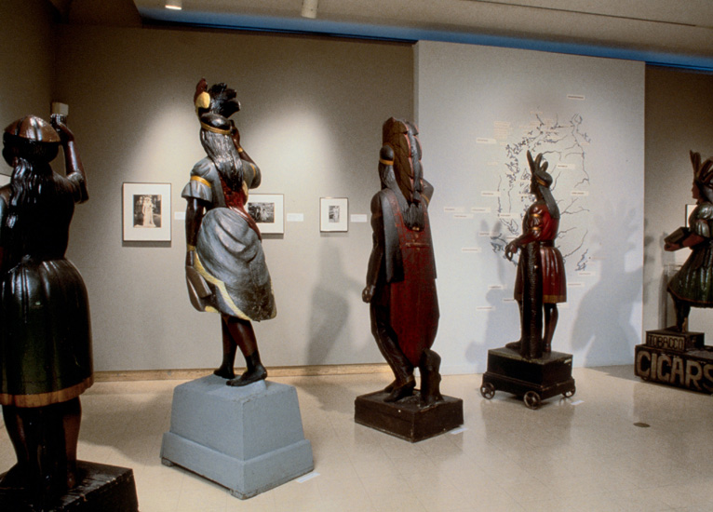
Mining The Museum (installation shot)
Fred Wilson
date: 1992

Slide 4
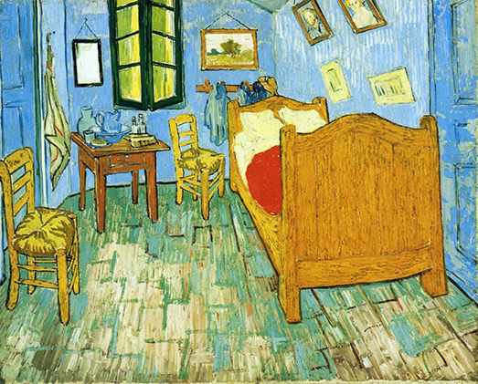
Bedroom in Arles
Vincent van Gogh
date: 1888

Slide 5
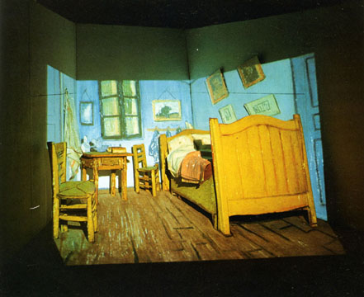
Van Gogh's Room
Murray Favro
date: 1973-1974

Slide 6
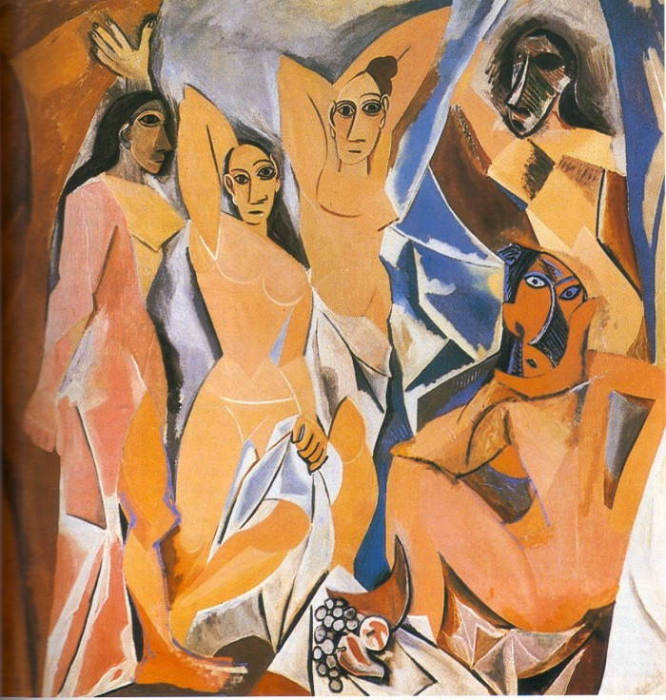
Les Demoiselles d'Avignon
Pablo Picasso
date: 1907

Slide 7
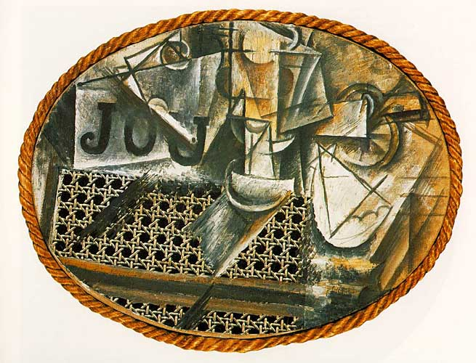
Still Life with Chair Canning
Pablo Picasso
date: 1912

Slide 8
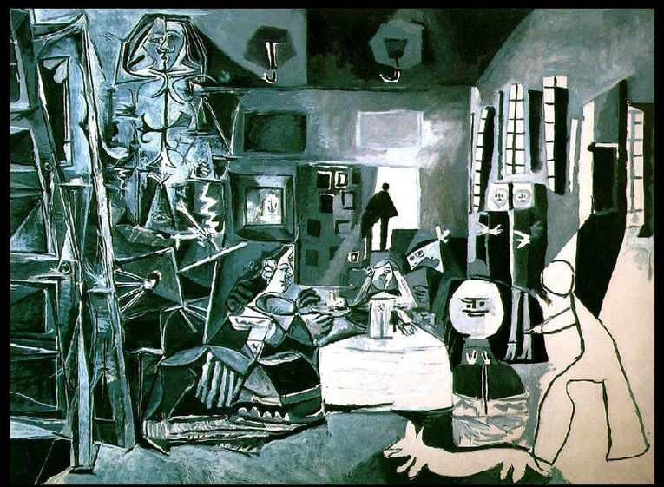
Las Meninas
Pablo Picasso
date: 1957

Slide 9
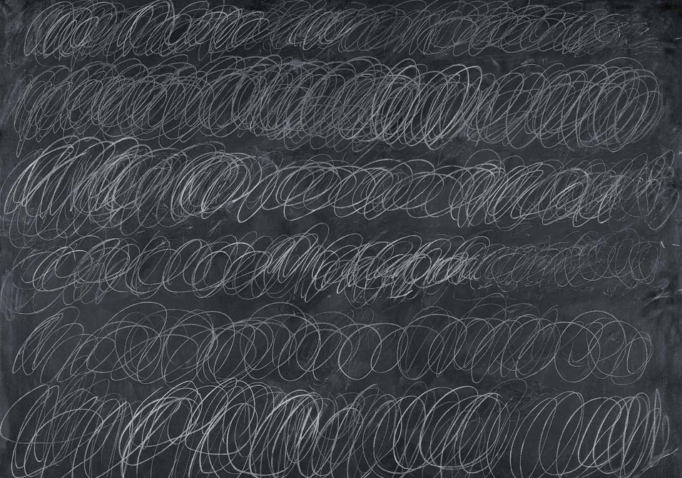
Cold Stream
Cy Twombly
date: 1966

Slide 10
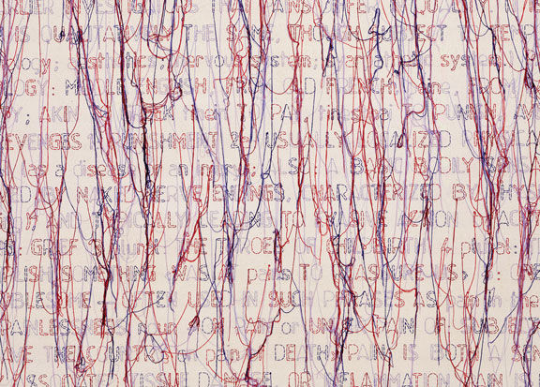
Pain
Ghada Amer
date: 2005

Slide 11
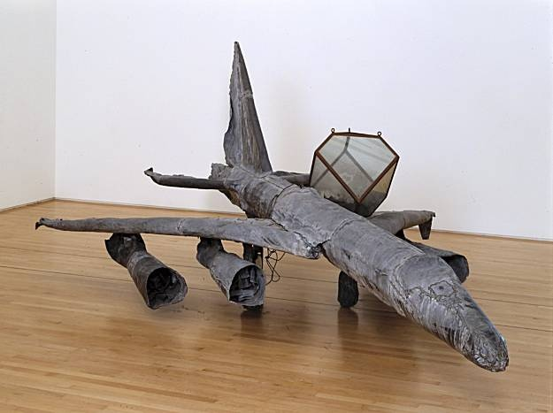
Melancholia
Anselm Kiefer
date: 1990-91

Slide 12
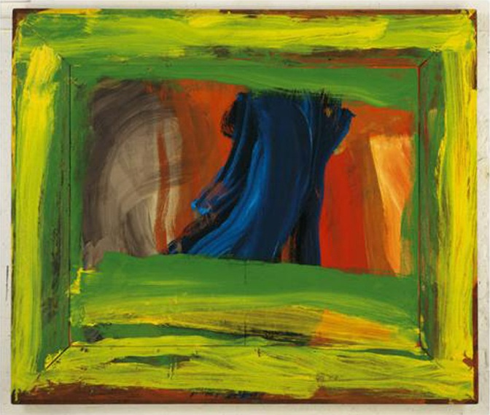
Night and Day
Howard Hodgkin
date: 1997-1999

Slide 13
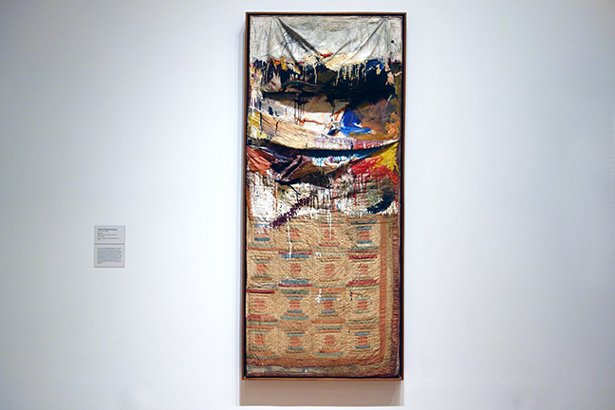
Bed
Robert Rauschenberg
date: 1955

Slide 14
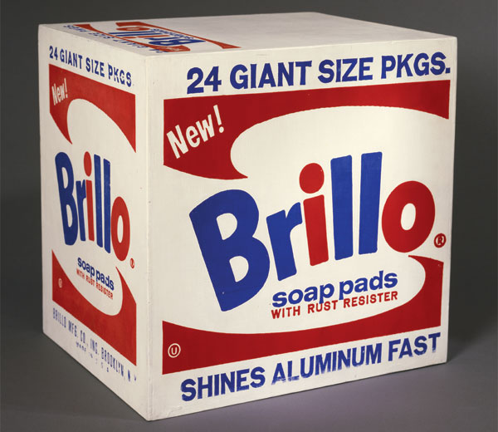
Brillo Soap Pads Box
Andy Warhol
date: 1964

Slide 15
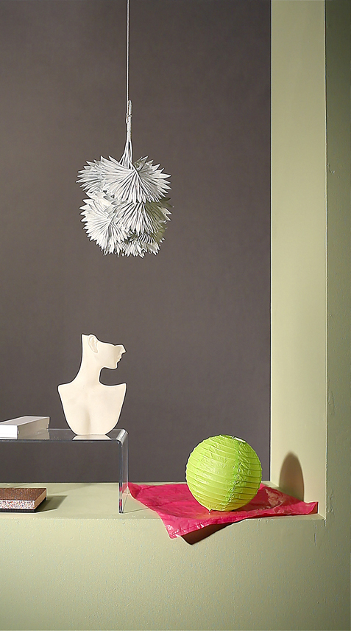
Canvas, Leaves, Torso, Lantern
Owen Kydd
date: 2011
http://www.mbam.qc.ca/en/exhibitions/on-view/owen-kydd/

Slide 16
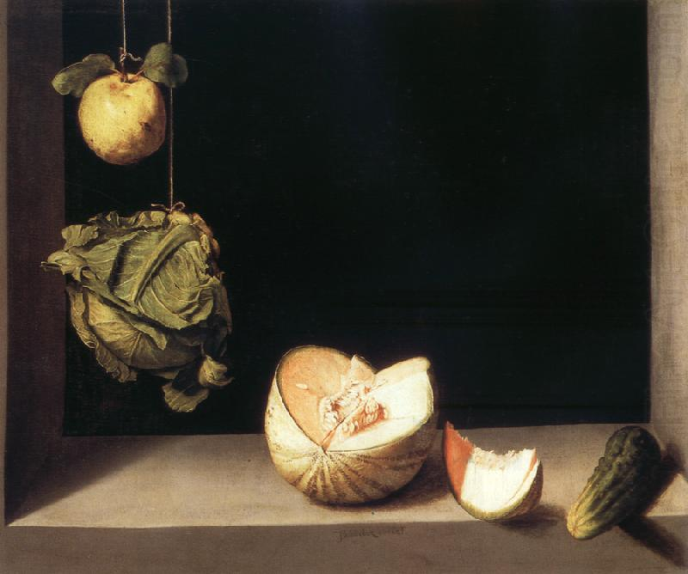
Still Life with Quince, Cabbage, Melon and Cucumber
Sanchez Cotan
date: c. 1602

Slide 17
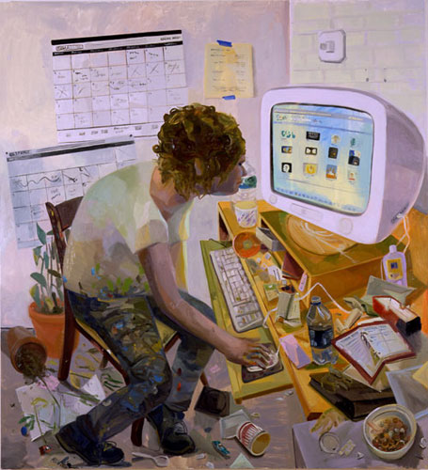
Google
Dana Schutz
date: 2006

Slide 18
http://www.telegraph.co.uk/culture/culturevideo/artvideo/10408677/David-Hockney-unveils-his-iPad-art.html
http://www.barrydoupe.ca/videos/object-poems

